Slide 1
String Buffer Class Methods
momedaram

Slide 2
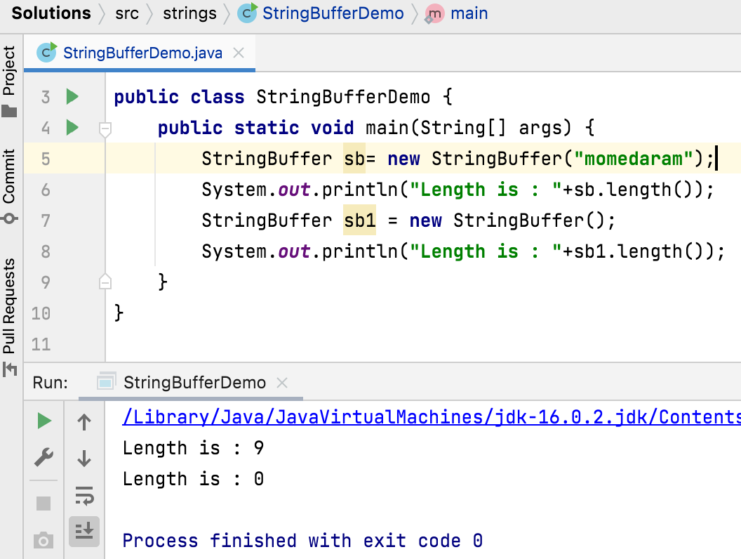
public int length() Returns the length of the sequence of characters represented by this object.

Slide 3
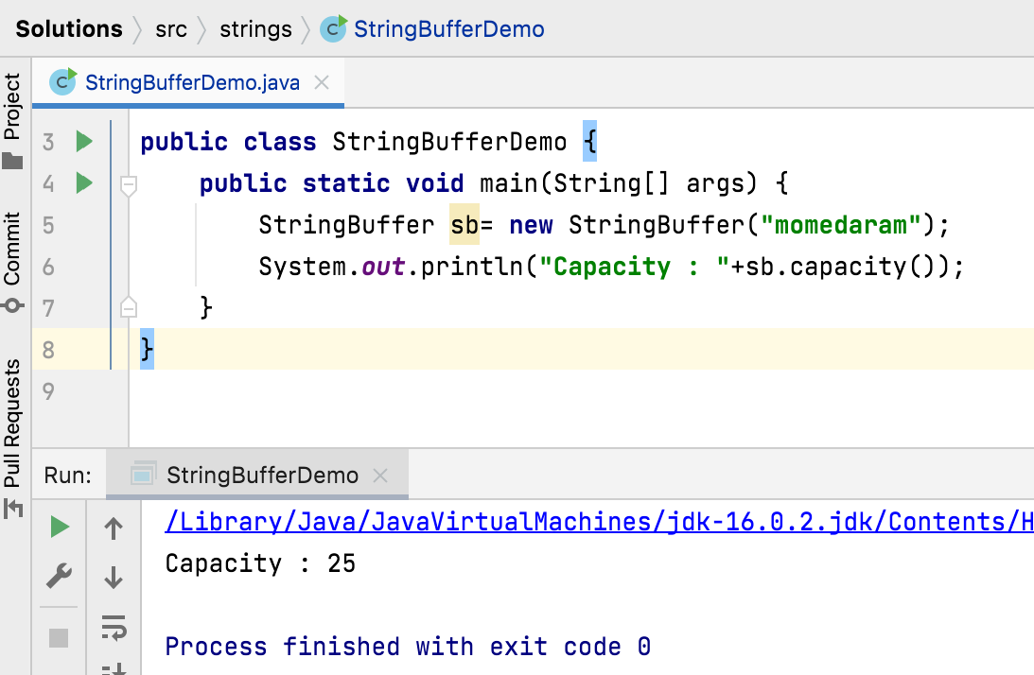
public int capacity() Returns the current capacity. The capacity is the amount of storage available for newly inserted characters, beyond which an allocation will occur.

Slide 4
public char charAt(int index)
Returns the char value at the specified index.
An index ranges from 0 to length() - 1.
The first char value of the sequence is at index 0, the next at index 1, and so on.
This method my throw StringIndexOutOfBoundsException - if index is negative or larger than the length of this StringBuffer object.

Slide 5
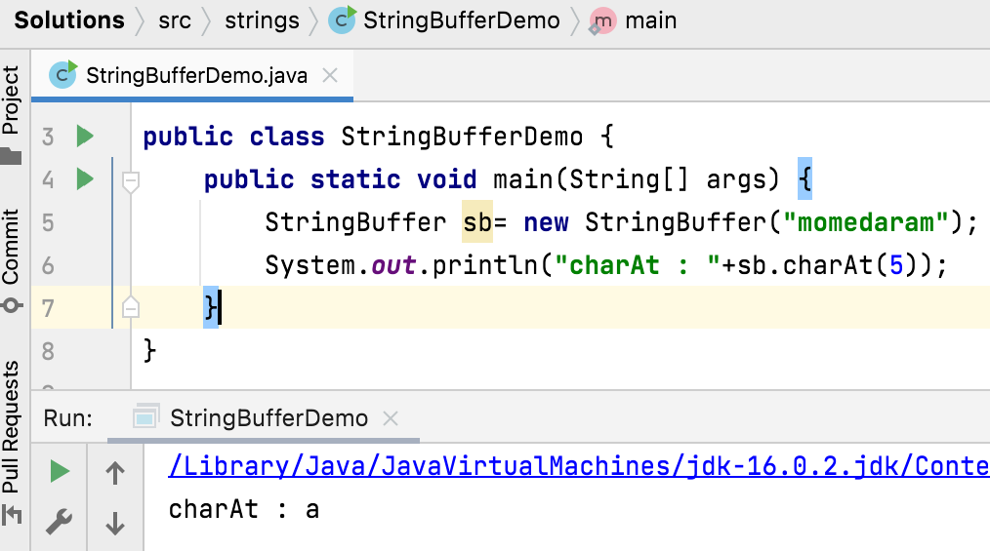
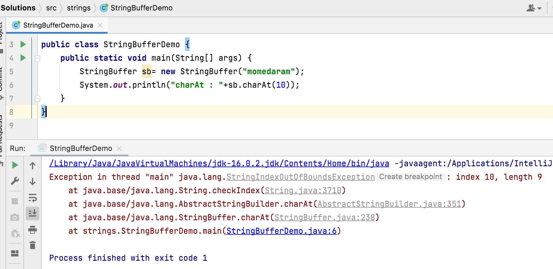

Slide 6
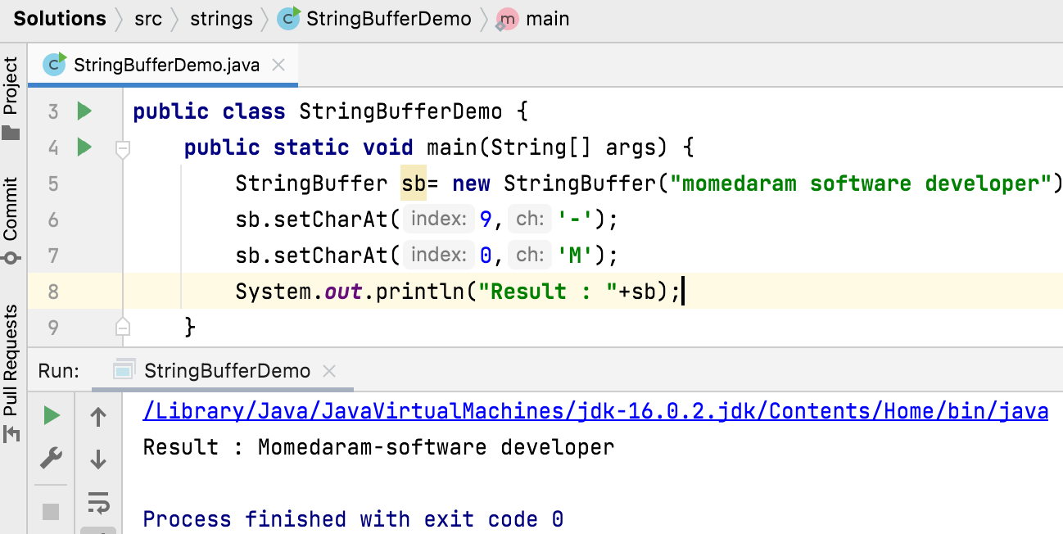
public void setCharAt(int index, char ch)
The character at the specified index is set to ch.
The index argument must be greater than or equal to 0, and less than the length of this sequence.
This method my throw IndexOutOfBoundsException - if index is negative or greater than or equal to length().

Slide 7
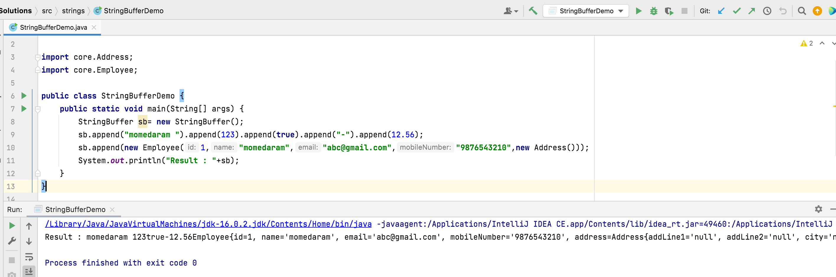
public StringBuffer append(String str)
Appends the specified string to this character sequence.
append method is overloaded method that is we can able to append the Object, StringBuffer , String, char[], boolean, char, int , long , float , double etc…

Slide 8
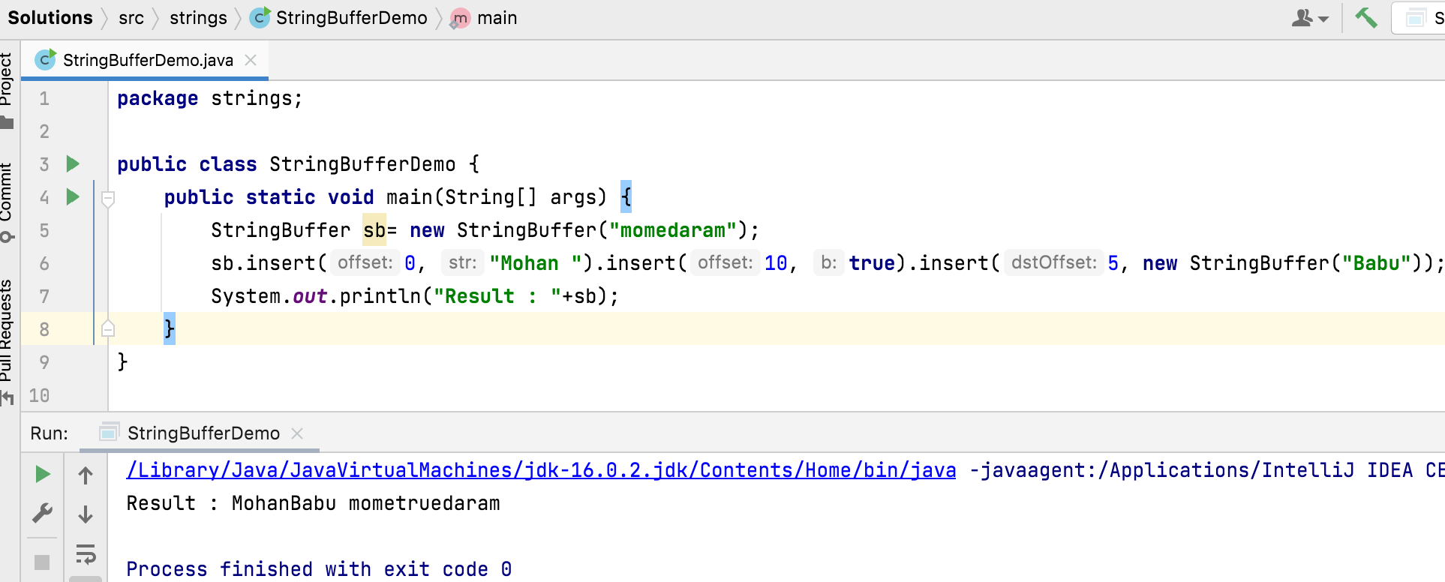
public StringBuffer insert(int index, String str)
The characters of the String argument are inserted, in order, into this sequence at the indicated index.
insert method is overloaded method that is we can able to insert the Object, StringBuffer , String, char[], boolean, char, int , long , float , double etc… in specified index.

Slide 9
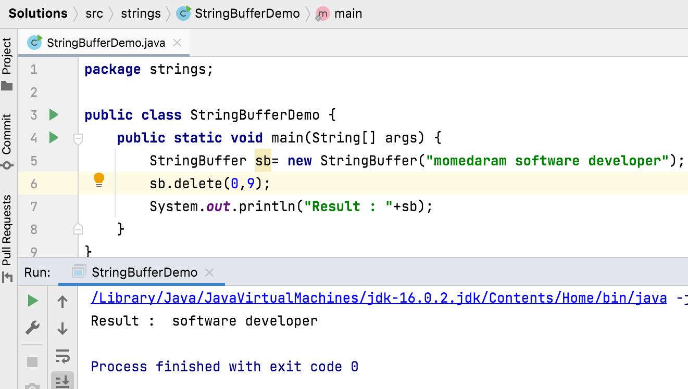
public StringBuffer delete(int start, int end) Removes the characters in a substring of this sequence. The substring begins at the specified start and extends to the character at index end - 1 .
This method may throw StringIndexOutOfBoundsException - if start is negative, greater than length(), or greater than end.

Slide 10
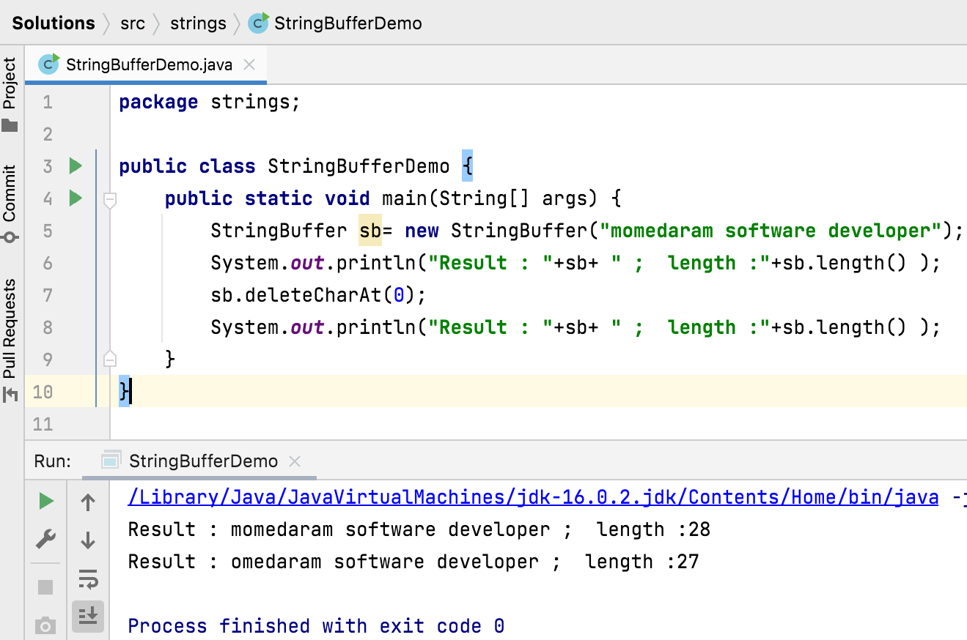
public StringBuffer deleteCharAt(int index) Removes the char at the specified position in this sequence. This sequence is shortened by one char.
This method may throw StringIndexOutOfBoundsException - if start is negative, greater than length(), or greater than end.

Slide 11
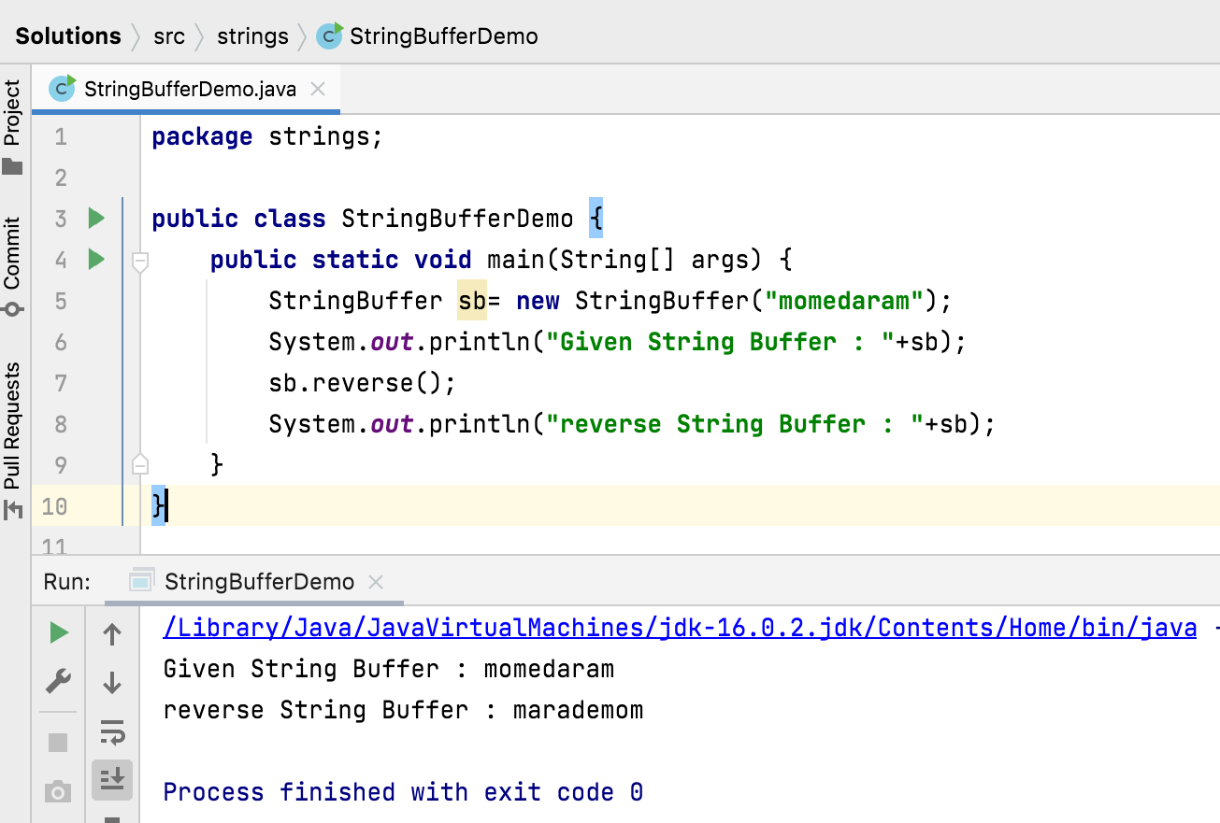
public StringBuffer reverse() Causes this character sequence to be replaced by the reverse of the sequence.

Slide 12
public void setLength(int newLength)
Sets the length of the character sequence. The sequence is changed to a new character sequence whose length is specified by the argument.
The newLength argument must be greater than or equal to 0.
If the newLength argument is greater than or equal to the current length, sufficient null characters ('\u0000') are appended so that length becomes the newLength argument.
This method may throw StringIndexOutOfBoundsException - if the newLength argument is negative.

Slide 13
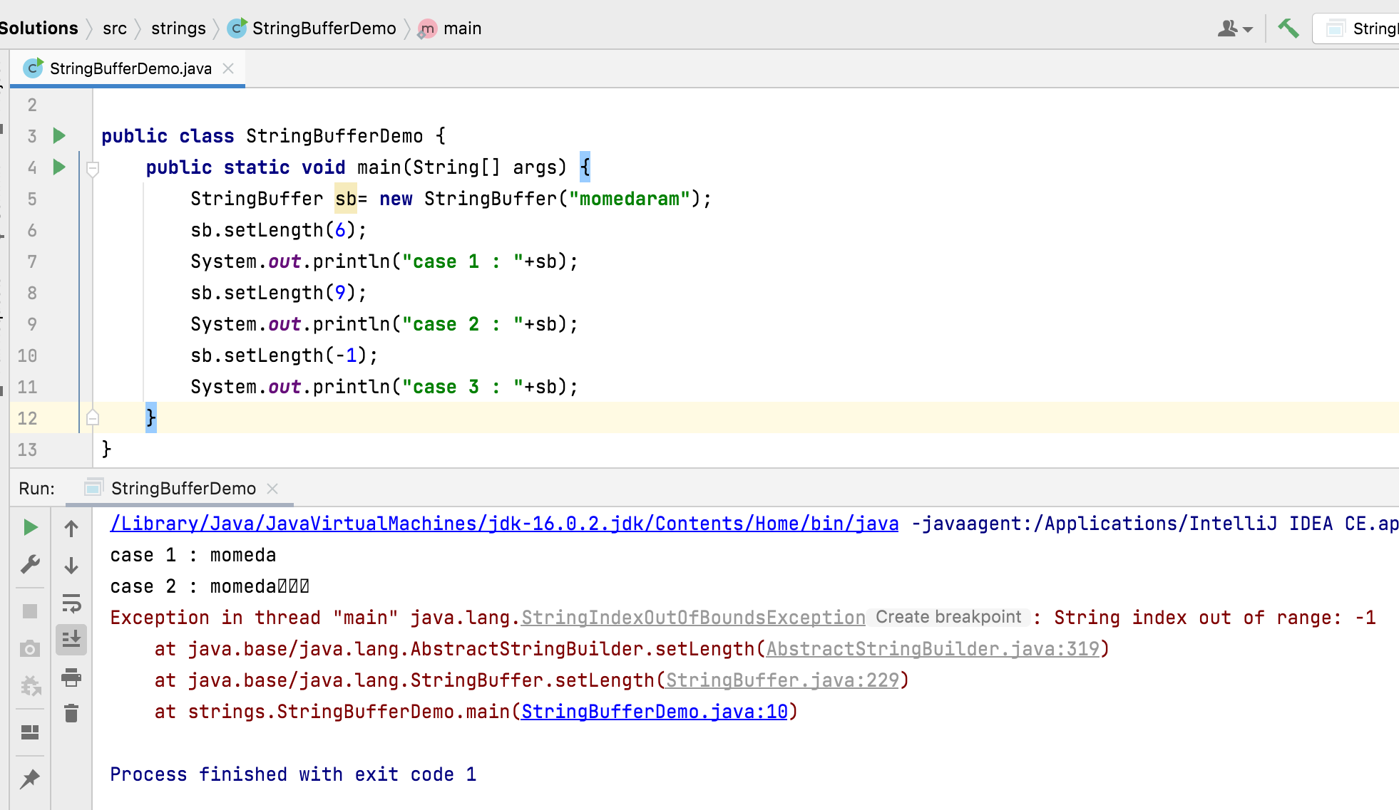

Slide 14
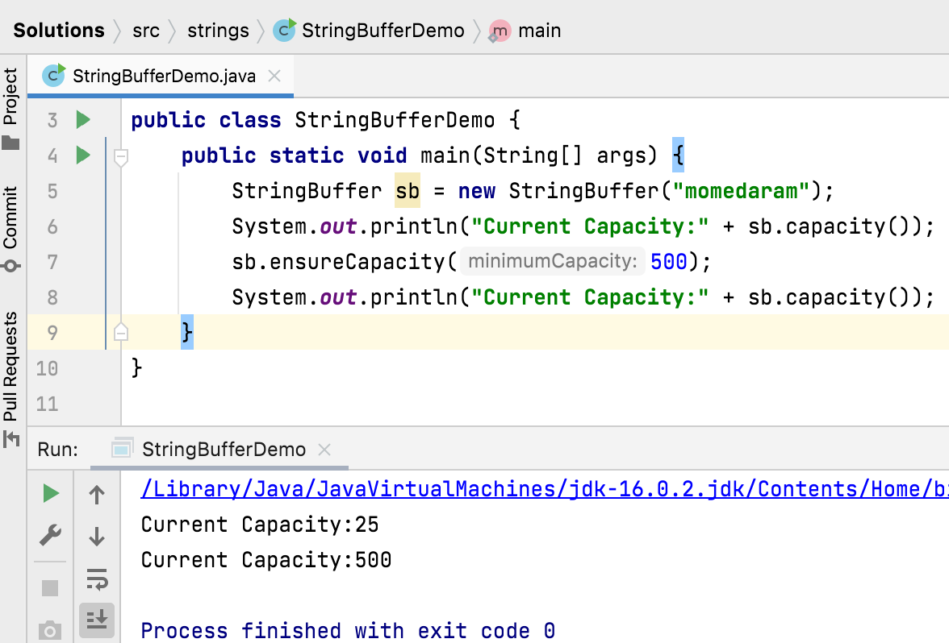
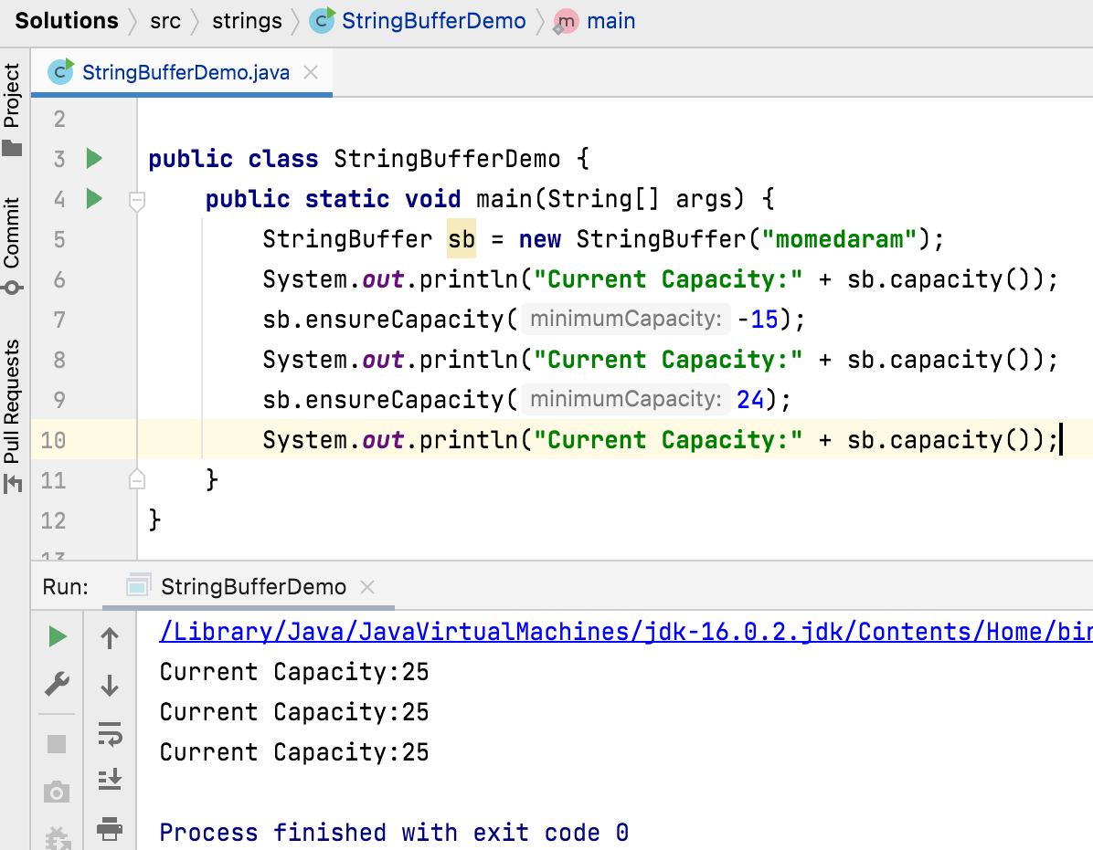
public void ensureCapacity(int minimumCapacity)
Ensures that the capacity is at least equal to the specified minimumCapacity.
If the minimumCapacity argument is nonpositive/ less than cc, this method takes no action and simply returns.

Slide 15
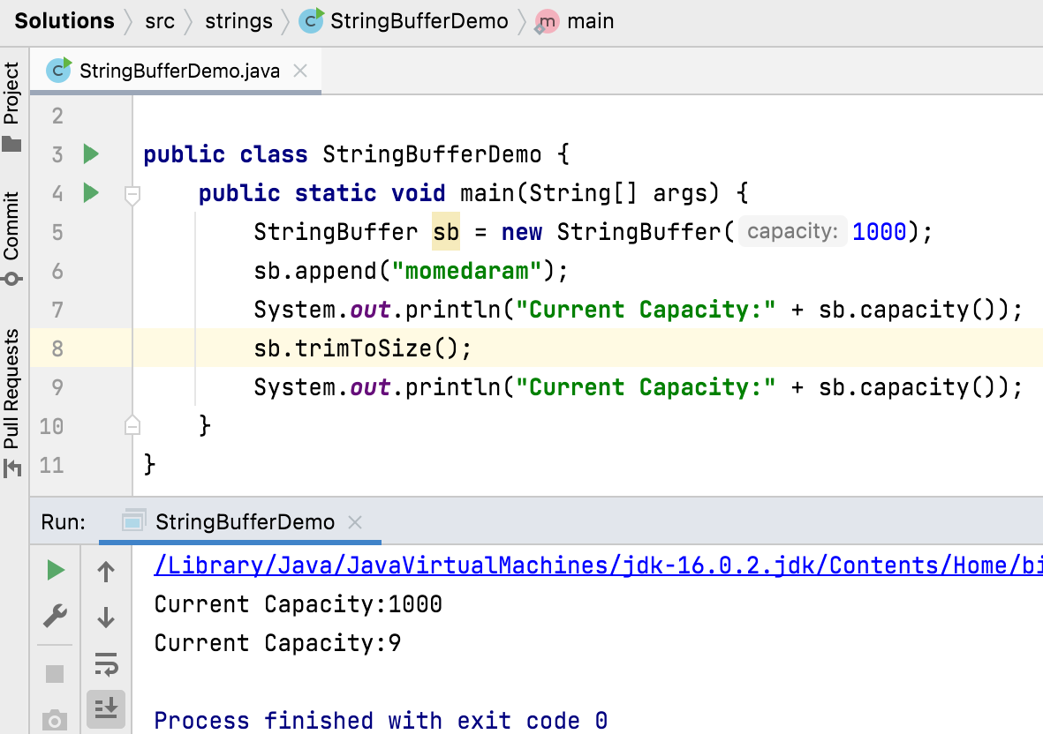
public void trimToSize()
Attempts to reduce storage used for the character sequence. If the buffer is larger than necessary to hold its current sequence of characters, then it may be resized to become more space efficient.

Slide 16
Thank You !
momedaram

